Slide 1
BY
P.RAJESH, M.Tech.,
Assistant Professor
CRITCOLLEGE OF ENGINEERING
ANANTAPUR

Slide 2
CONTENTS:
Introduction.
Block diagram of ON board micro controllers.
Architecture of micro controllers.
Pin diagram.
Register structure of micro controllers.
Memory organization and I/P and O/P ports.
Timers and counters.
Serial input and output ports.
Interrupts.

Slide 3
INTRODUCTION:
MICRO PROCESSORS
Microprocessors are single chip CPUs used in microcomputers.
Micro processors and micro controllers are different in many aspects.
Hardware architectures, instruction sets and applications are some of the main aspects.

Slide 4
HARDWARE ARCHITECTURES:
Micro processor is a single chip CPU .
Micro controller is a single IC which contains CPU and much of remaining circiutry of a complete computer.
Ex: RAM, ROM, Timers, Counters, serial ports and interrupts.
APPLICATIONS:
Micro processors are commonly used as CPU’s in computers.
Micro controllers are used in minimum component designs performing control oriented activities.
INSTRUCTION SET:
Micro processor instruction sets operate on nibble, byte or words and their addressing modes provide access to large array of data.
Micro controllers have instruction sets for I/P and O/P operations , enabling and setting priority levels for interrupts.

Slide 5
8051 & 8052 MICRO CONTROLLERS
INTEL corporation first designed 8051 micro controllers.
Later several manufacturers introduced no of chips in 8051 series.
8051 chips are different in terms of memory, capacity, counters, timers, no of ports etc.

Slide 6
BLOCK DIAGRAM OF ON BOARD 8051 MICRO CONTROLLER.
CPU
RAM
ROM
SFR’s
TIMERS
AND
COUNTERS
I/P
AND
O/P
PORTS
CLOCK
INTERRUPTS
ADC
SERIAL
PORTS
Fig: (1)

Slide 7
CPU:
CPU means central processing unit.
It consists of arithmetic and logic unit, control unit and few registers.
It can perform bit wise as well as byte wise manipulations.
RAM & ROM:
Two memories RAM and ROM are used to store operands and program codes.
CLOCK:
Every function is carried out within the predetermined time interval. The whole operation of micro controller is synchronized with clock. A quartz crystal oscillator is used for synchronization.
TIMER:
Timer is used to maintain time interval in certain applications.
COUNTER:
Counter is used for counting the events happened around the microcontroller.
INTERRUPT:
Interrupt is an input to controller which alters the attention from present task to some other task.

Slide 8
ADC and DAC:
ADC is called as Analog to digital converters.
DAC is called as Digital to analog converters.
They are used in processing analog and digital signals.
SPECIAL FUNCTION REGISTERS:
Registers are used to store the data temporarily.
Data may be opcodes, operands or address of a peripheral or address of a memory location.
Some of the SFR’s are
Accumulator.
B-Register.
Program counter.
Data pointer.
Program status word.
Stack pointer.
TMOD, TCON, SCON, PCON & SBUF.
Interrupt Priority (IP) & Interrupt Enable (IE)

Slide 9
I/P & O/P PORTS:
There are 4 I/O ports in a microcontroller.
Some of these ports can be configured as an input or as output ports.
Latch, buffer & driver are built in these ports to perform some specified actions.
SERIAL PORTS:
This unit provides serial data transfer.
This feature is required in certain communications.

Slide 10
ARCHITECTURE OF 8051 MICRO CONTROLLER.
External interrupts
On-chip ROM for program code
Timer/Counter
Interrupt Control
On-chip RAM
Timer 1
Counter Inputs
Timer 0
CPU
Bus Control
Serial Port
4 I/O Ports
OSC
P0 P1 P2 P3
TxD RxD
Address/Data
Fig: (2)

Slide 11
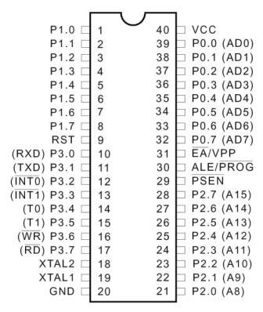
PIN DIAGRAM OF 8051 MICRO CONTROLLER
Fig: (3)

Slide 12
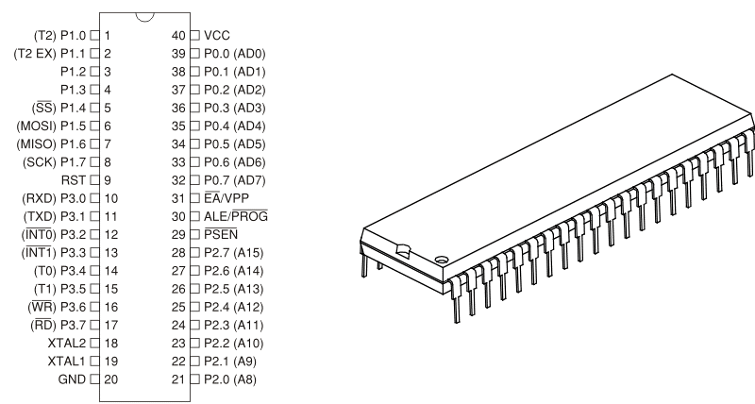
ISOMETRIC VIEW OF MICROCONTROLLER 8051
Fig: (4)

Slide 13
FEATURES OF 8051 MICRO CONTROLLER
Total pins: 40
Data lines: 08
Address lines : 16
I/O lines: 32
Interrupt lines: 02
Registers: 34 (8 bit) and 02 (16 bit)
Internal ROM: 4KB
Internal RAM: 128 BYTES.
Flags: 04
Timers and counters: 02
Serial port: 01
Parallel ports: 04
contd…..

Slide 14
40 pin micro controller is available in plastic and ceramic packages.
All 40 pins are easily distinguishable and carries out specified functions.
A brief discussion of these pins is explained here under.
Pin 1-8: Total of 8 lines named as port 1 which can be used for input or output. (P1.0-P1.7)
Pin 9: RESET. Active high input used to reset the controller and terminate all activities.
Pin 10-17: A total of 8 lines named as port 3 can be used for both input and output. (P3.0-P3.7)
P 3.0: (RXD) – data received in serial form.
P 3.1: (TXD) – data transmitted in serial form.
P 3.2: (INT0) – hardware interrupt.
P 3.3: (INT1) – hardware interrupt.
P 3.4: (T0) – pulse input given to counter 0.
contd…..

Slide 15
P 3.5: (T1) – pulse input given to counter 1.
P 3.6: (WR) – A control signal activates memory (I/O device) for write operation.
P 3.7: (RD) – A control signal activates memory (I/O device) for read operation.
Pin 18-19: A Quartz crystal oscillator and capacitors formed as a pulse generator and is connected to inputs XTAL1 and XTAL2 to run the on chip oscillator.
Pin 20: GROUND. This is return pin for supply.
Pin 21-28: A total of 8 lines named as port -2 can be used for input and output. These lines provides high order address byte (A8-A15) through which 8051 can access 64kB of memory. (P2.0-P2.7)
Pin 29: PSEN. “Program store enable” is an output pin used to access the external program memory (ROM).
contd…..

Slide 16
Pin 30: ALE. “Address latch enable” is an output pin used to latch the low order address byte (A0-A7). This is used for demultiplexing address and data.
Pin 31: EA. “ External access” is an input pin used to access the external program code memory (ROM) only.
Pin 32-39: A total of 8 lines named as port -0 can be used for input and output. In addition these lines provides a dual function carrying address and data. (P0.0-P0.7)
Pin 40: VCC: This is +5V supply voltage pin.

Slide 17
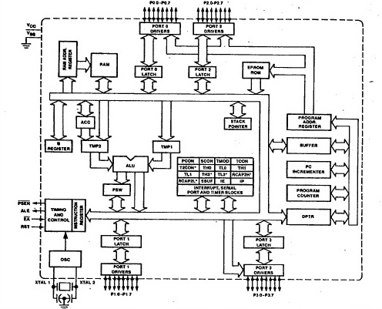
INTERNAL ARCHITECTURE OF 8051 MICRO CONTROLLER
Fig: (5)

Slide 18
REGISTER STRUCTURE OF 8051 MICRO CONTROLLER
Registers are used to store the data temporarily.
Data can be opcodes, operands or address of memory location or address of a peripheral.
8051 has wide range of registers. They are:
Bit addressable (or) byte addressable.
General purpose (or) specific purpose.
8-bit length (or) 16-bit length.
Independent (or) dependent (part of RAM).
Contd….

Slide 19
Registers can be classified into 4 types based on the method of transfer of data. They are
Serial In Serial Out register (SISO).
Serial In Parallel Out register (SIPO).
Parallel In Serial Out register (PISO).
Parallel In Parallel Out register (PIPO).
Contd….

Slide 20
Apart from the above classification, following are the various registers used in microcontroller. They are also called as special function registers (SFR’s). They are:
32 registers of 8 – bit wide which are part of internal RAM.
Accumulator.
B-Register.
Program counter.
Data pointer.
Program status word.
Stack pointer.
TMOD, TCON, SCON, PCON & SBUF.
Interrupt Priority (IP) & Interrupt Enable (IE).
Contd….

Slide 21
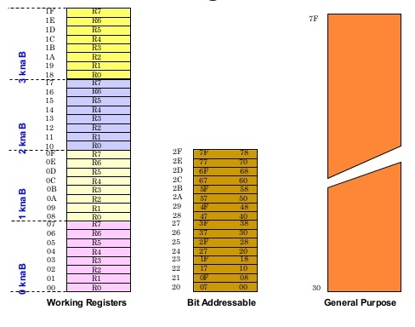
32 registers of 8 – bit wide which are part of internal RAM.
Fig: (6)
Contd….

Slide 22
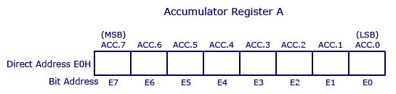
Accumulator (A)
Fig: (7)
Accumulator is an 8 bit register.
It is denoted by letter ‘A’.
It is used to store one of the operands and run time results.
When transferring data from one register to another register it has to go through the accumulator.
It is the most frequently used register.
Contd….

Slide 23
B-Register (B)
B Register is of 8 bit length.
This register is used only in multiplication and division operations to store one of the operands with accumulator.
Program counter (PC)
Program counter is of 16 bit length.
It is used to hold the address of memory (ROM) location where the program codes are stored.
It always points to the address of an instruction to be executed next.
While execution of program, 8051 has to fetch the instructions one after the other and data can be manipulated as per the opcode of an instruction.
Therefore contents of PC is always incremented by one after every fetch operation.
Contd….

Slide 24
Data pointer (DPTR)
Data pointer is also a 16 –bit register.
It is operated as two 8 bit registers named as DPL & DPH.
It is used in addressing off chip RAM & ROM.
It can access a maximum memory of 64 k Bytes.
DPTR
≈
DPH
DPL
15 0
15 8 7 0
Fig: (8)
Contd….

Slide 25
Program status word (PSW)
Program status word is a 8 bit register.
It has 4 flags.
Flag is an indication representing the result status of an arithmetic or logical operations.
8051 has carry flag, auxiliary flag, overflow flag and parity flag.
Carry flag: This flag is set when carry or borrow is generated at MSB.
Auxiliary flag: This flag is set whenever carry is generated from B3 to B4 position.
Overflow flag: This flag is set whenever the result of signed number addition overflows into B7 bit.
Parity flag: This flag is set whenever the data of accumulator has odd number of logical 1.
Contd….

Slide 26
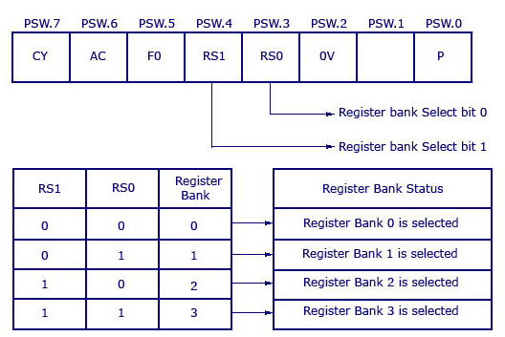
Fig: (9)
Two bits of PSW can be used for bank selection and part of RAM.
PSW is a bit addressable register.
All the bits of PSW can be selectively enabled/ disabled.
Contd….

Slide 27
Stack pointer (SP)
Stack pointer is an 8 bit register.
It can be used to access the stack.
When 8051 is powered up SP contains value 07H.
TMOD and TCON
8 bit length registers.
These registers are used to control the functions built in timer / counter of a microcontroller.
IP and IE
8 bit length registers.
They are used to manage interrupts like enabling, disabling, assigning priority etc.,

Slide 28
SCON, PCON and SBUF
These three registers are used for serial communication.

Slide 29
MEMORY ORGANIZATION OF 8051 MICRO CONTROLLER
8051 requires memory for program and data.
ROM is used for storing program code.
RAM is used for storing data.
8051 can access 64KB ROM and 64KB RAM.
8051 uses same address for both ROM and RAM.
Total memory space can be divided into two parts.
They are: internal (on-chip) RAM/ROM and external (off chip) RAM/ROM.
Contd….

Slide 30
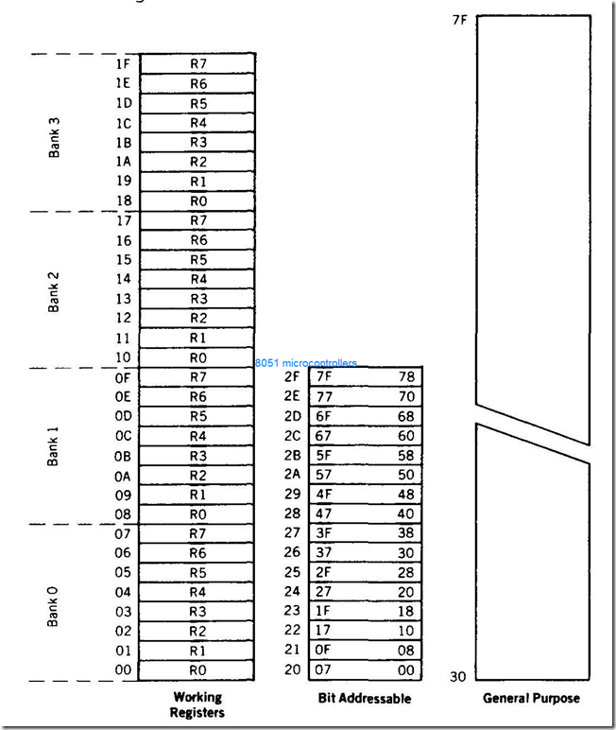
ON chip (internal ) RAM/ROM:
Internal RAM ( i- RAM) is of 128 bytes and internal ROM is of 4KB.
Fig: (10)
Contd….

Slide 31
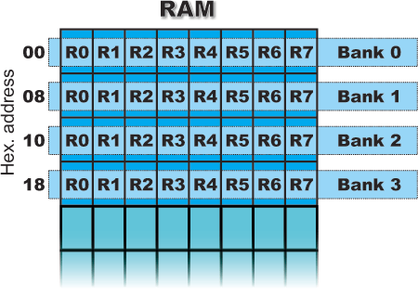
BANKS in RAM
Contd….

Slide 32
OFF chip (internal ) RAM/ROM:
External RAM is of 64K bytes and external ROM is of 64KB.
External Access (EA) pin determines the accessing of exact memory i.e., on-chip or off-chip
FFFFH
0000H
Off chip ROM 64KB
FFFFH
1000H
OFF chip ROM 60KB
0FFFH
0000H
ON chip ROM 4KB
EA = GND
EA = VCC
Fig: (11)

Slide 33
TIMERS/COUNTERS OF 8051 MICRO CONTROLLER
It becomes necessary to maintain some delay in doing some tasks or to count the number of external events by microcontroller.
8051 has built in circuitry with timers and counters.
8051 contains two 16 bit timers/counters named as T0 & T1.
These 16 bit timers/counters are divided into two 8 bit registers.
They are TLO, THO & TL1, TH1.
B15 B14 B13 B12 B11 B10 B9 B8 B7 B6 B5 B4 B3 B2 B1 B0
TIMER 0
THO
TLO
Fig: (12)
Contd….

Slide 34
B15 B14 B13 B12 B11 B10 B9 B8 B7 B6 B5 B4 B3 B2 B1 B0
TH1
TIMER 1
TL1
Fig: (13)
These four registers TH0, TL0, TH1,TL1 can be accessed like any other registers.
Contd….

Slide 35
HOW DOES A TIMER COUNT ?
In timer mode, it will count the internal clock frequency of 8051 by 12 divisions.
When timer is at timer mode and when it is configured correctly, it gets incremented by ONE for every machine cycle.
8051 uses 11.09MHz crystal .
Machine cycle equals 12 clock cycles.
1,10,59,000/12=9,21,583 Machine cycles/sec.
Counter increments 9,21,583 times / second.
So, if timer has counted from 0-50,000 you may calculate 50,000/ 9,21,583 = 0.542sec.

Slide 36
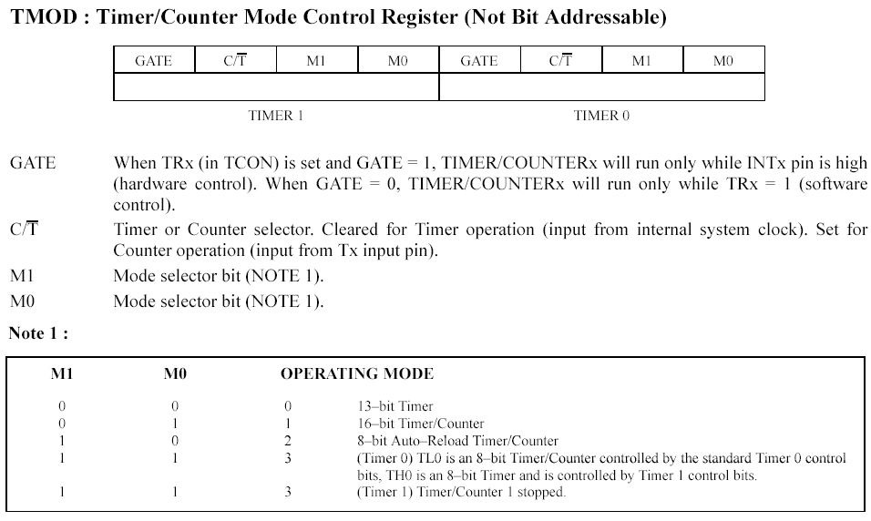
Contd….

Slide 37
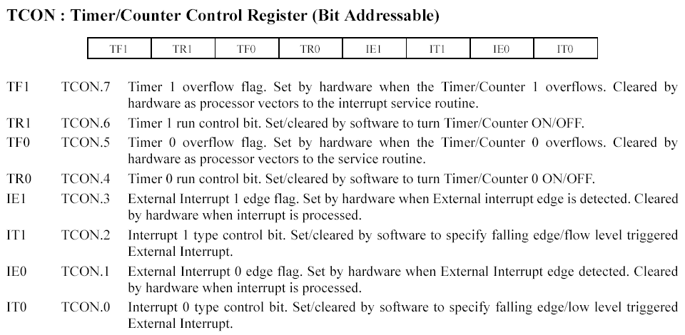
Contd….

Slide 38
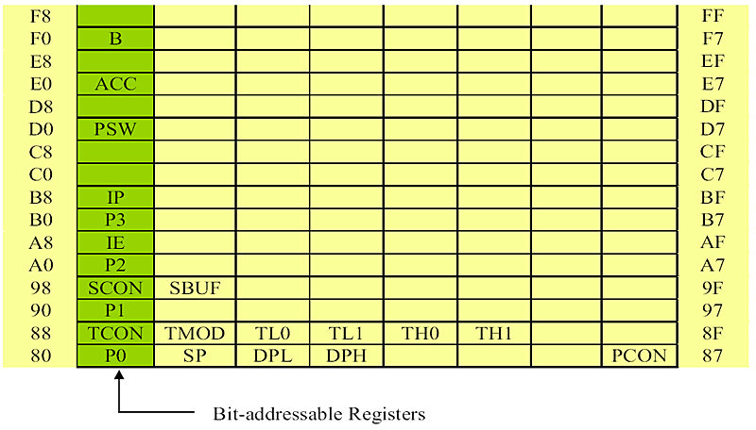
REGISTER BANK:

Slide 39
SERIAL INPUT AND OUTPUT PORTS OF 8051 MICRO CONTROLLER
8051 transfers 8 bit of data simultaneously.
It is expensive method and it requires 8 transmission lines between sender and receiver.
Parallel data transmission is possible in long distance communication, so serial input and output mode is used.
In serial data transmission data must be converted to serial bits using a parallel in serial out register (PISO).
At receiving end there must be a serial in parallel out register (SIPO).
In serial transmission, data is formed in synchronous and asynchronous format.
In synchronous format, group of bytes are transmitted at a time.
In asynchronous format, only one byte is transmitted at a time.
Contd….

Slide 40
Serial data communication can be classified according the direction of data flow. They are
SIMPLEX: in this method only one device can transmit a data. Flow of data exists in either one direction only.
8051
Output device
Data flow
Output device
8051
Data flow
Fig: (14)
Contd….

Slide 41
HALF DUPLEX: in this method only one line can be used . Flow of data exists in both directions.
8051
Data flow
8051
Data flow
8051
Data flow
8051
Data flow
Fig: (15)
Contd….

Slide 42
FULL DUPLEX: In this method data flow exists in both directions at a time. This method requires two transmission lines.
8051
8051
Data flow
Contd….

Slide 43
SERIAL COMMUNICATION – SFR’S
8051 has fast data transfer rate.
The internal circuit which is responsible for serial transmission is SBUF with 2 pins RXD and TXD.
Two SFR’s i.e., SCON is used for controlling serial data communication and PCON is used for data transfer rate
Contd….

Slide 44
SBUF:
SBUF is physically 2 registers of 8 bit each.
One register is used to hold the data to be transmitted out of 8051 through TXD pin.
Other is read only and holds received data from external source through RXD pin.
Serial communication is implemented in asynchronous format .
In this each byte is accompanied with 2 bits namely START and STOP.
Each character is of 10 bit length.
Here baud rate determines the no of bits transmitted per second.
Contd….

Slide 45
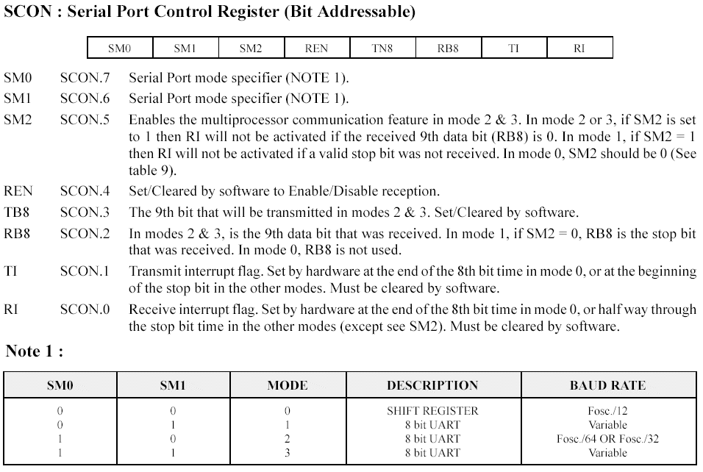
SCON monitors the serial data transfer. It is a 8 bit and bit addressable register.
Contd….

Slide 46
PCON :
It is a power control register 0f 8 bit length.
It is a byte addressable register.
Contd….

Slide 47
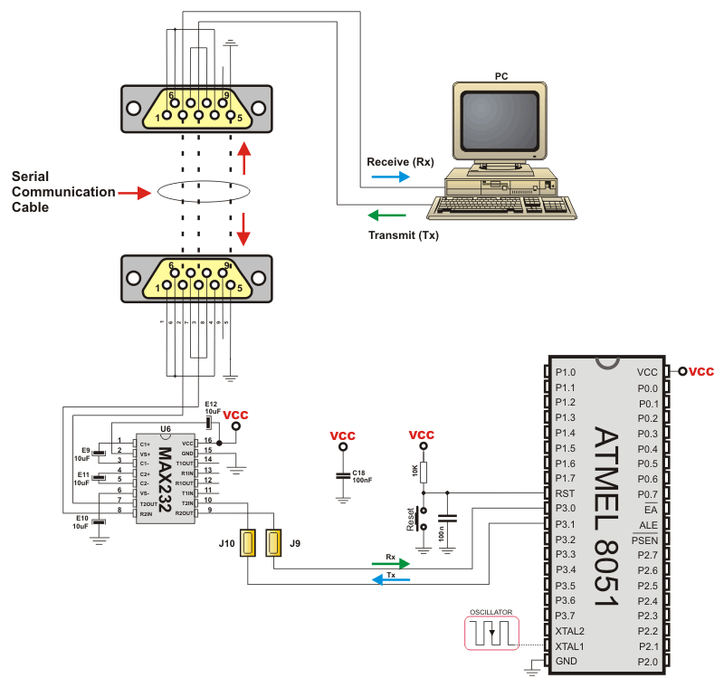

Slide 48
INTERRUPTS IN 8051 MICRO CONTROLLER
Interrupt is an external or internal event that interrupts the controller to inform that a device needs its service.
The running program execution is temporarily suspended and 8051 can alter it into some other program. This is called as Interrupt service routine (ISR).
8051 has 5 interrupts such as TF0 and TF1, TI /RI, INT0 and INT1.
Contd….

Slide 49
Interrupt process:
Let us assume that controller is executing a program.
Before completion of this execution, an interrupt may become active then 8051 completes the current instruction only.
It saves the address of next instruction and its status in stack.
Its attention is transferred to a memory location where ISR has been stored.
Completes the execution of ISR.
Then ISR is terminated by an instruction.
Now 8051 begins the execution of previous program from where it has been stopped earlier.
Contd….

Slide 50
INTERRUPT SFR’s
Interrupt enable (IE):
It is an 8 bit SFR.
This register is used to enable or disable the interrupt.
Upon reset, all interrupts are disabled.
It is a bit addressable register.
Interrupt priority (IP):
It is an 8 bit SFR.
This register is used to alter the priority.
Contd….

Slide 51
PRIORITY OF INTERRUPTS:
External Interrupt: INT0 ( Highest priority).
Timer Interrupt: TFO
External Interrupt: INT1
Timer Interrupt: TF1
Serial Interrupt: R1/T1 ( lowest priority).

Slide 52
END
OF
CHAPTER 1

Slide 53
CHAPTER 2 INSTRUCTION SET
OF
MICRO CONTROLLERS

Slide 54
INTRODUCTION:
Microcontroller performs different operations based on the instructions given to it.
The group of instructions given to a controller is called as “program”.
Depending upon the capacity of controller, designer will specify all its actions in a specified manner known as “Instructions”.
All instructions commonly grouped together is known as “Instruction set”.
Instructions can be written in machine understandable language or user understandable language.
Machine understandable language is known as “machine language”.
User understandable language is known as “ assembly language”.
Machine language has only two alphabets i.e., 0 & 1.
Assembly language can also be called as high level language which contains English words.

Slide 55
Need of instruction set:
Microcontroller is designed to perform several operations such as transfer operations, arithmetic operations and logical operations.
Operations are specified with English alphabets known as “Mnemonics”.
Combination of mnemonics and operands is called as “Command”.
Instruction format of 8051:
Label Opcode Operand Comment

Slide 56
Opcode: It specifies the type of operation to be performed.
Operands: Operand is the data to be operated. Here address or data is specified. Address is of 2 parts i.e., source and destination.
Label: It allows the program to refer a line of code by name.
Comment: It describes the type of operation to be performed.
S no: | Instruction |  | Comment
 | Mnemonic | Operands
1 | ADD | A,R3 | Data of R3 register is added to data of A register
2 | SUBB | A,R5 | Data of R5 register is subtracted to data of A register
3 | MOV | Direct, A | data of A register is moved to internal RAM location.

Slide 57
Instruction cycle, fetch cycle and execution cycle.
Instruction cycle: Instruction cycle is a time interval required by microcontroller to execute an instruction. Clock is used to sequence all the operations which are required to execute an instruction.
Fetch cycle: Fetch cycle is the time taken by 8051 for fetching an opcode.
Execution cycle: Execution cycle is the time taken by 8051 for executing an opcode.
Smallest time interval to accomplish any simple instruction or part of a complex instruction is known as
“ Machine cycle”.
Instruction cycle (T): = (C*12)/Crystal frequency.
Let f = 20MHz.
20MHz/12 = 1.66MHz. Length of machine cycle = 1/1.66MHz = 0.60µsec.
Length of T-state = 0.60µsec/6 = 0.10µsec

Slide 58
Difference between machine language and assembly language
MACHINE LANGUAGE | ASSEMBLY LANGUAGE
Opcodes and operands are represented by 0 and 1 | Opcode is represented by short sequence of English words known as mnemonic and operand is in the form of hexadecimal number system.
Speed of execution is very high. | Slow in execution.
No need of translator. | Translator is required.
Difficult to read, understand and rewrite | Easy to read understand and rewrite.
Difficult to debug. | Easy to debug.
Error prone language. | Less chance of errors.
Lengthy program. | Program length can be minimized.
More memory space is required. | Memory space can be saved.

Slide 59
One byte, two byte and three byte instructions:
One byte instructions: An instruction is a combination of opcode as well as operand.
Ex:ADD A, Rn = ADD A, R3
Two byte instructions: Here first byte refers opcode and second byte represents operand.
ADD A, # data = ADD A, #30H.
Three byte instructions: here first byte refers opcode, second byte refers data or address of data , third byte also represents data or address of data.
Ex: MOV direct, # data. = MOV direct , #45H.

Slide 60
FLAGS:
Flags are used to represent the status of the instruction given to 8051 microcontroller.
Flags are classified into 4 types in 8051 microcontroller. They are:
Carry flag (CY).
Parity flag (PF).
Overflow flag (0F).
Auxiliary flag (AF).

Slide 61
Addressing modes of 8051:
Addressing mode is the way how data can be represented.
There are six types of addressing modes in 8051. they are:
Immediate addressing mode: In this mode always source operand represents data rather than address.
data is available in instruction itself. Data is followed by symbol #.
Ex: MOV Rn, #nH; Rn nH;
MOV R3, # 92H;
ADD A, # 78H;
Register addressing mode: In this mode register can be used as operand. Register name appears as part of opcode.
Ex: MOV Rn, A; Rn A;
INC Rn;
ADD A, Rn;

Slide 62
Register indirect addressing mode: In this mode register banks of RAM can be used. There registers are used to hold the address of data.
Ex: MOV A, @ Rn ;
ADD A, @Rn;
Direct addressing mode: In this mode all SFR’s and i- RAM can be used as data pointers. RAM locations can be addressed.
Ex: MOV Rn, direct ;
INC direct ;
ORL direct, A ;
Register specific addressing mode: In this mode registers are particularly specified. They are mentioned as a part of op-code.
Ex: RL A;
INC DPTR ;
Indexed mode: This kind of addressing is preferred only for on chip or off chip program memory (ROM). Either DPTR or PC can be used as registers.
Ex: MOVC A, @A+DPTR;
MOV DPTR, A;

Slide 63
Group of instructions:
Group of instructions are classified into five types. They are:
Data transfer group: These instructions are used to move either data or address of memory location. Usually flags do not affect these instructions. Opcodes used under this group are:
MOV, MOVC, PUSH, POP, XCH, XCHD.
Ex: MOV A, R3;
POP addr(8);
Arithmetic group: These instructions are used to perform addition, subtraction, multiplication, division, increment and decrement. Opcodes used under this group are:
ADD, SUBB, MUL, DIV, INC and DEC.
Ex: ADD A,R4;
SUB A, # data;
Logic group: These instructions are used to perform logical AND, OR, NOT and XOR. Opcodes under this group are:
ANL, ORL, XRL, CPL, SWAP and ROTATE.
Ex: ANL A, R4;
SWAP A;

Slide 64
Boolean variable group: These instructions are used to perform bit level operation instead of byte level operation. Opcodes used under this group are:
CLR, SETB C, CPLC, MOV C.
Ex: CLR C;
SETB C;
CPL C;
Program and machine control group: This group can also be called as “branch group”. Opcodes used under this group are:
JMP, CALL, RET.
Ex: AJMP addr (11)
A CALL addr (11)
RET.

